Slide 1
Capstone Project - 4
NETFLIX MOVIES AND TV SHOWS CLUSTERING
Shivam Pandey
(Cohort : Enlighten)

Slide 2
Points to discuss
Problem Statement
Data description
Exploratory data analysis
Feature selection
Machine learning algorithms(unsupervised)
K-mean
agglomerative clustering
Model performance
Conclusion

Slide 3
Problem statement
This dataset consists of tv shows and movies available on Netflix as of 2019. The dataset is collected from Flexible which is a third-party Netflix search engine.
In 2018, they released an interesting report which shows that the number of TV shows on Netflix has nearly tripled since 2010. The streaming services number of movies has decreased by more than 2,000 titles since 2010, while its number of TV shows has nearly tripled. It will be interesting to explore what all other insights can be obtained from the same dataset.
Integrating this dataset with other external datasets such as IMDB ratings, rotten tomatoes can also provide many interesting findings.
In this project, I have done
1.Exploratory Data Analysis
2.Understanding what type content is available in different countries
3.Is Netflix increasingly focusing on TV rather than movies in recent years.
4.Clustering similar content by matching text-based features.

Slide 4
Data description
The dataset consists of listings of all the movies and tv shows available on Netflix, along with details such as - cast, directors, ratings, release year, duration, etc
show_id : Unique ID for every Movie / Tv Show
type : Identifier - A Movie or TV Show
title : Title of the Movie / Tv Show
director : Director of the Movie
cast : Actors involved in the movie / show
country : Country where the movie / show was produced
date_added : Date it was added on Netflix
release_year : Actual Release Year of the movie / show
rating : TV Rating of the movie / show
duration : Total Duration - in minutes or number of seasons
listed_in : Genre
description: The Summary description

Slide 5



In this section I’ve loaded in the dependencies, like pandas, seaborn, and many more from the scikit learn library.
The next step was to mount the drive where the data was stored.
After mounting the drive I used the pandas.read_csv() function to read the data given to us in csv format.
Initial Preparation:

Slide 6
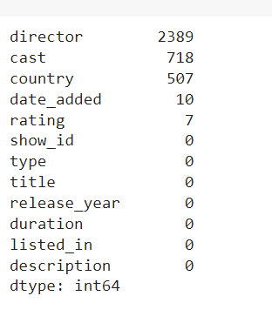
Missing Values:
There are 5 Columns Having Missing Values
1. Since 'date_added' and 'rating' has very less percentage of null count so we can drop those observations to avoid any biases in our clustering model.
2. We cannot drop or impute any values in 'director' and 'cast' as the null percentage is comparatively high and we do not know data of those actual movie/TV shows, so its better to replace those entries with 'unknown' and No cast.
3. We can fill null values of 'country' with mode as we only have 6% null values and most of the movies/shows are from US only.
.
.

Slide 7


Slide 8
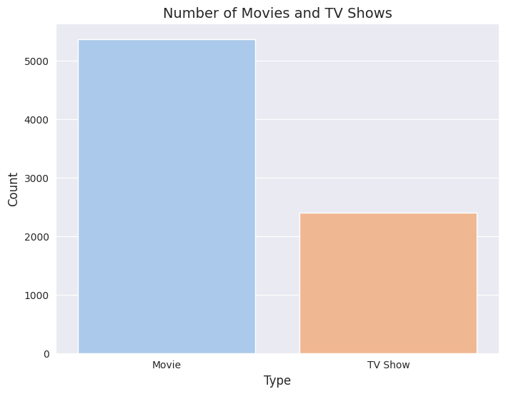
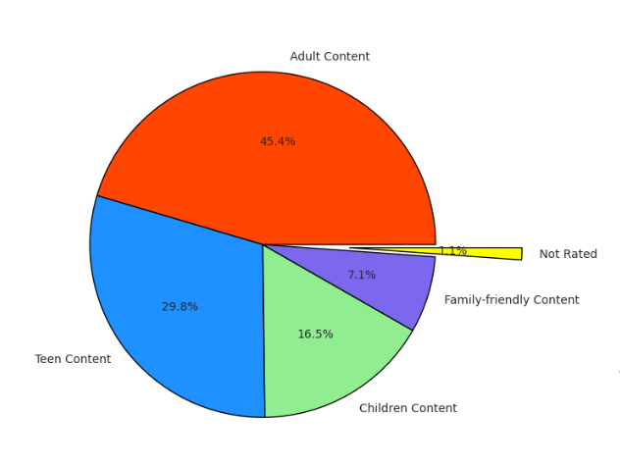
Type
Ratings
TV-MA has the highest number of ratings for tv shows i,e adult ratings
TV-MA has the highest number of ratings for movies i,e adult ratings
in both the cases TV-MA has the highest number of ratings
Netflix has 5372 movies and 2398 TV shows,there are more number movies on Netflix than TV shows.

Slide 9
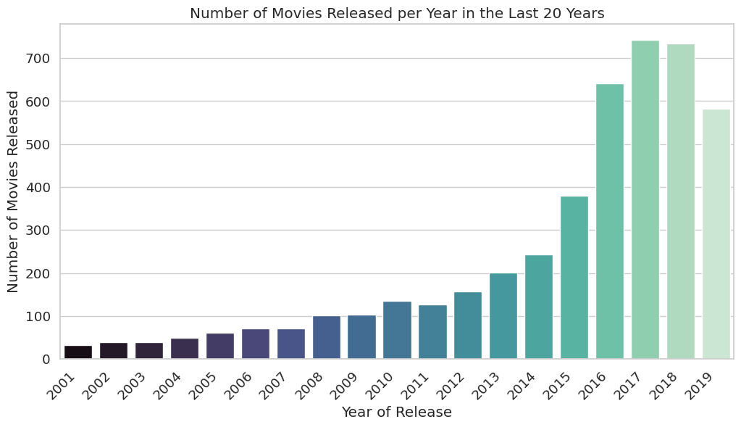
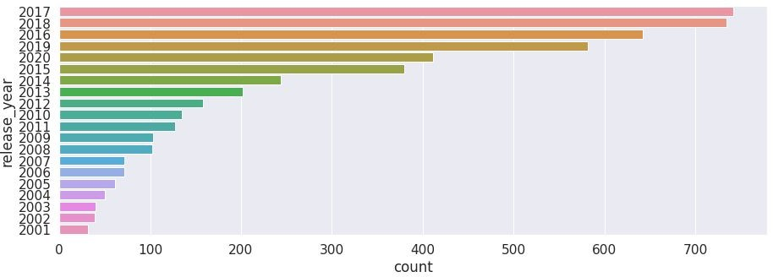
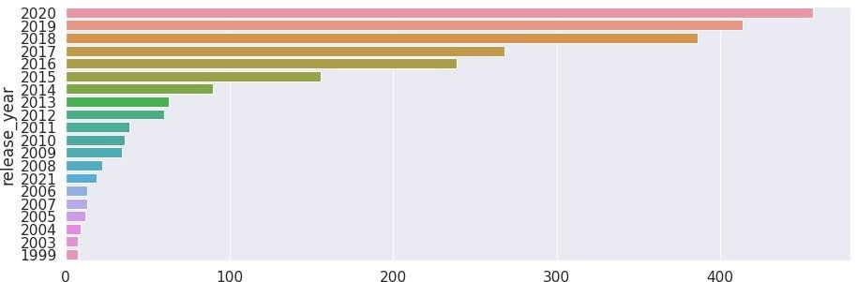
Release year
tv_shows
highest number of movies released in 2017 and 2018
highest number of movies released in 2020
The number of movies on Netflix is growing significantly faster than the number of TV shows.
We saw a huge increase in the number of movies and television episodes after 2015.
there is a significant drop in the number of movies and television episodes produced after 2020.
movies

Slide 10
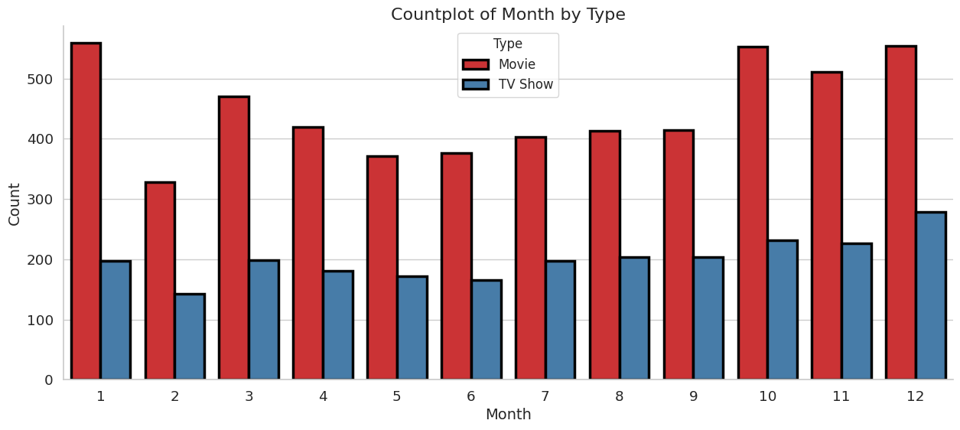
Release month
The above graph shows that in both cases the most content is added to Netflix from october to january

Slide 11
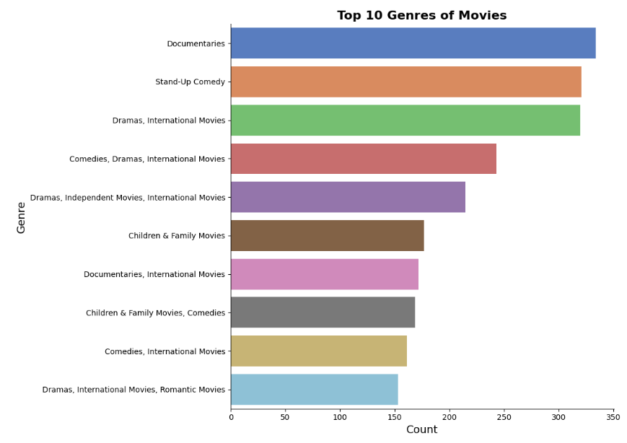
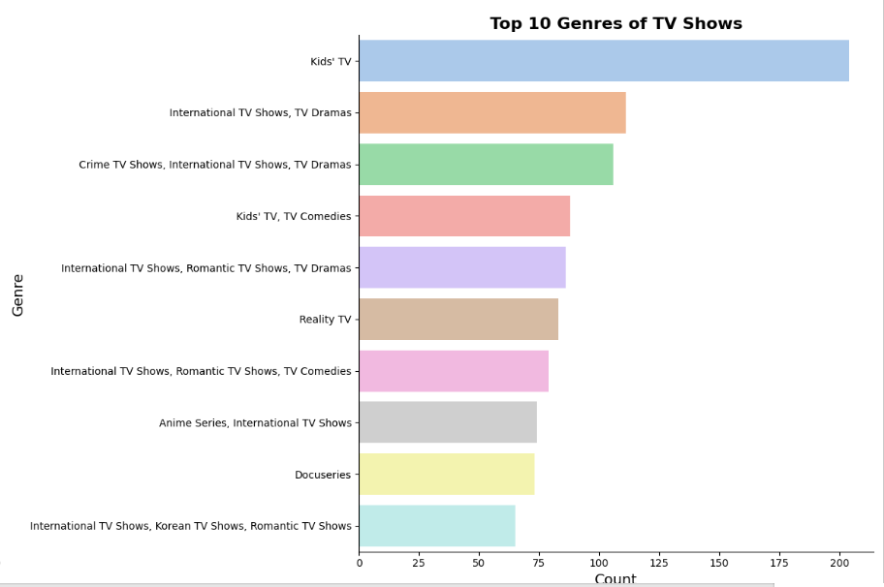
Top 10 Genre Of Movies and Tv Shows
Documentaries are the top most genre in netflix which is followed by stand up comedy and Drama and international movies.
Kids tv is the top most TV show genre in netflix.

Slide 12
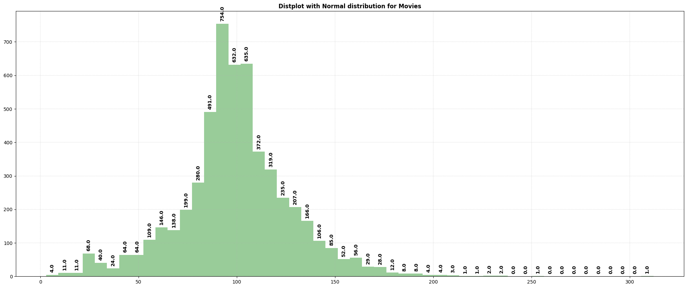
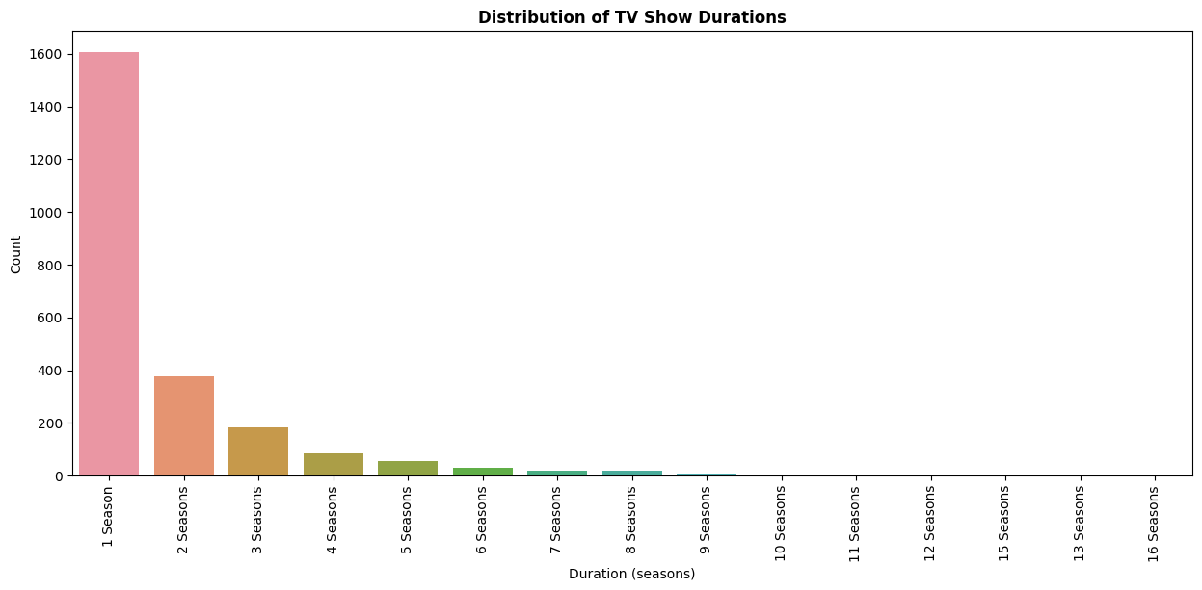
Duration
Highest number of tv_shows consisting of single season
Most of the movies have duration of between 50 to 150
.

Slide 13
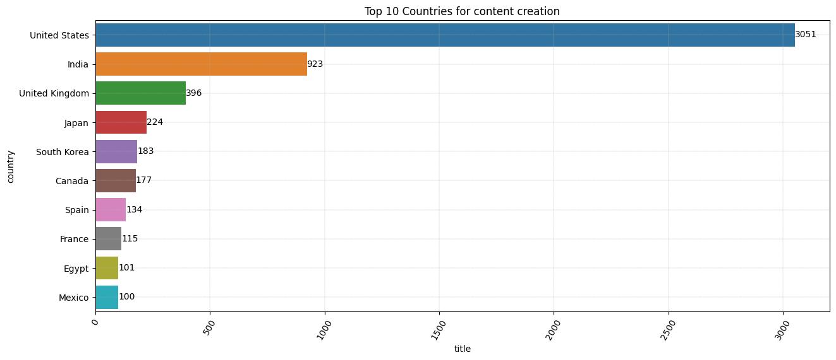
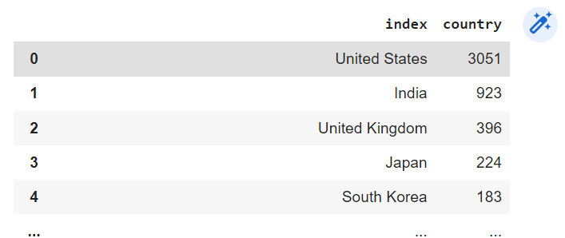
Top 10 Countries For Content Creation
United states has the highest number of content on the netflix ,followed by india
india has highest number of movies in netflix
The Countries US and UK are closely aligned with their Netflix target ages, but radically different from, example, India or Japan!
Also, Mexico and Spain have similar content on Netflix for different age groups.

Slide 14
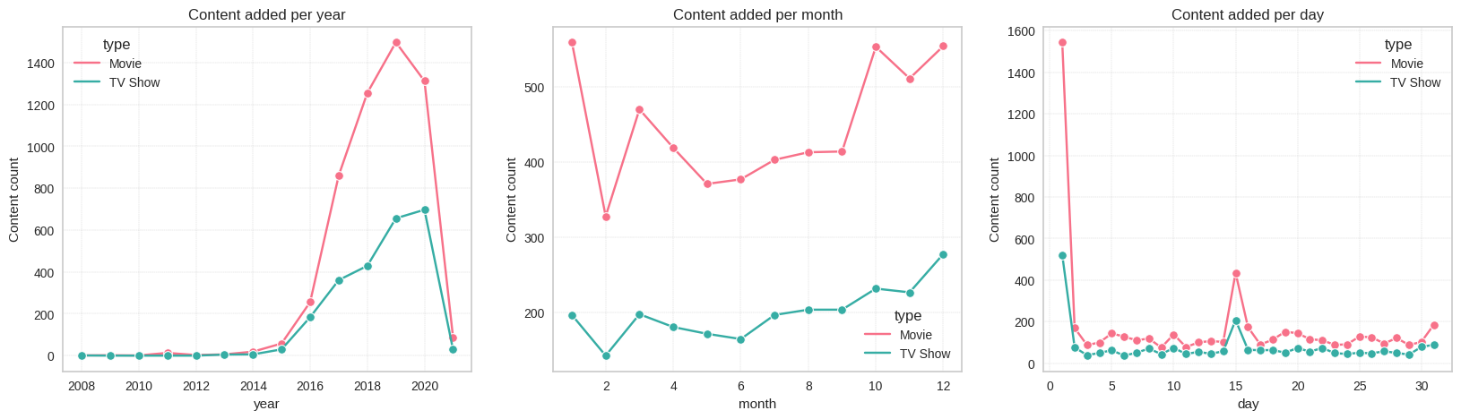
Contents Added By(Year,Month,Day)
It is interesting to note that only 30% of the movies available on the platform were actually released by Netflix themselves.
The remaining 70% of movies were added to Netflix after being released by different modes, such as theaters or other streaming platforms.

Slide 15
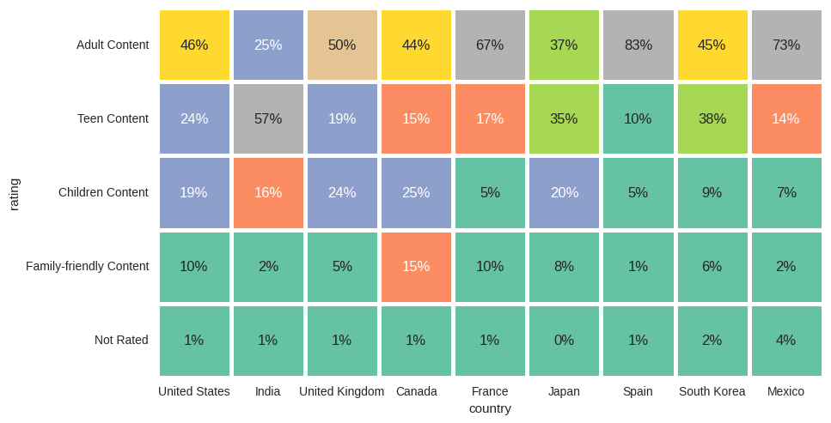
Correlation

Slide 16
Feature
Engineering

Slide 17
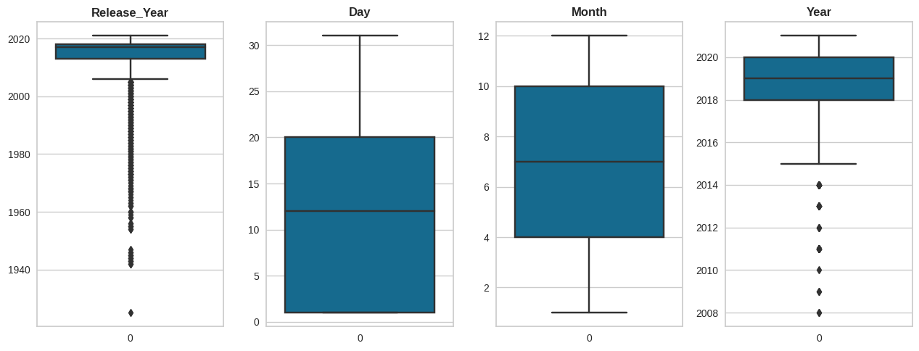
Outliers Treatment
Except for the release year, almost all of the data are presented in text format.
The textual format contains the data we need to build a cluster/building model. Therefore, there is no need to handle outliers.

Slide 18
Features selection
Initially Separating the column type into movie and tv shows
here we are going to do Clustering similar content by matching text-based features so column description is one of the important feature
Convert the text to lowercase
Tokenize the text
Removed all the stop words and punctuation
I use TF-IDF is an abbreviation for Term Frequency Inverse Document Frequency. This is very common algorithm to transform text into a meaningful representation of numbers which is used to fit machine algorithm for prediction

Slide 19
Model
Formulation

Slide 20
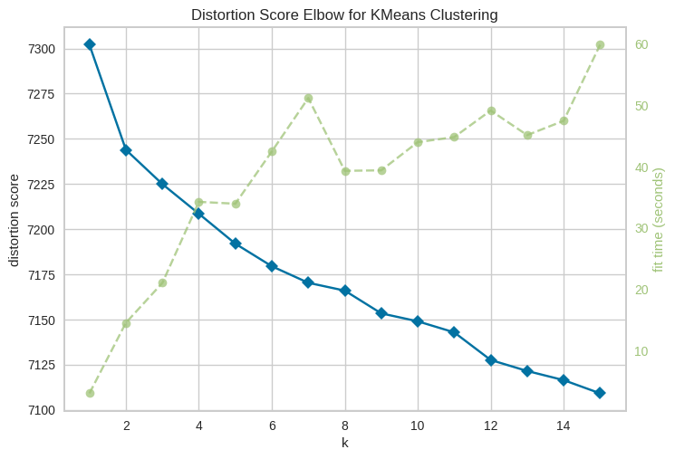
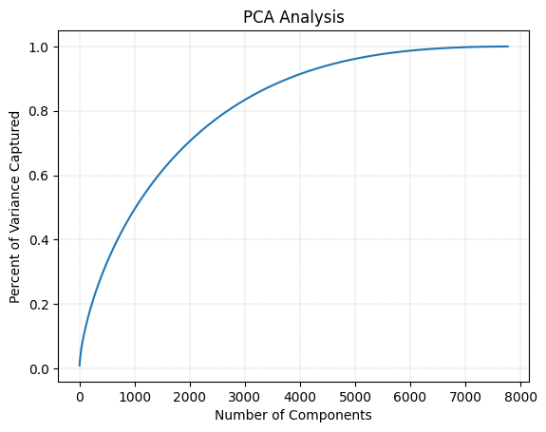
K-Means:
K-Means Clustering is an Unsupervised Learning algorithm which groups the unlabeled dataset into different clusters. Here K defines the number of predefined clusters that need to be created in the process, as if K=2, there will be two clusters, and for K=3, there will be three clusters, and so on.
Elbow Method
Result:
From elbow method generating 16 clusters
Cluster 0 has the highest number Of data points and evenly distributed for other cluster.

Slide 21
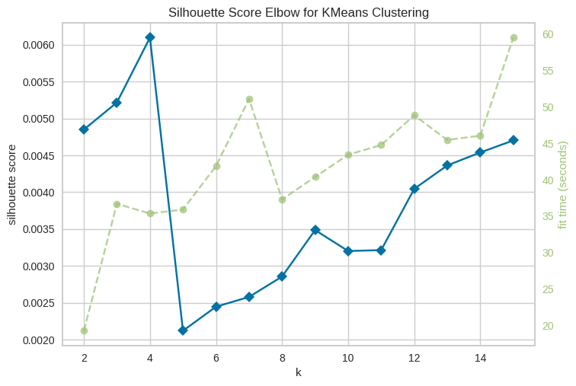
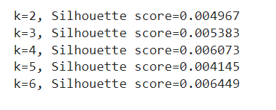
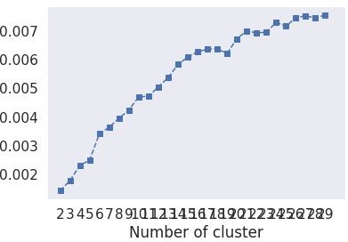
Evaluation
1.Silhouette Score : is a metric to evaluate the performance of clustering algorithm. It uses
compactness of individual clusters(intra cluster distance) and separation amongst clusters (inter
cluster distance) to measure an overall representative score of how well our clustering algorithm
has performed
silhouette score would always lie between -1 to 1. 1
representing better clustering

Slide 22
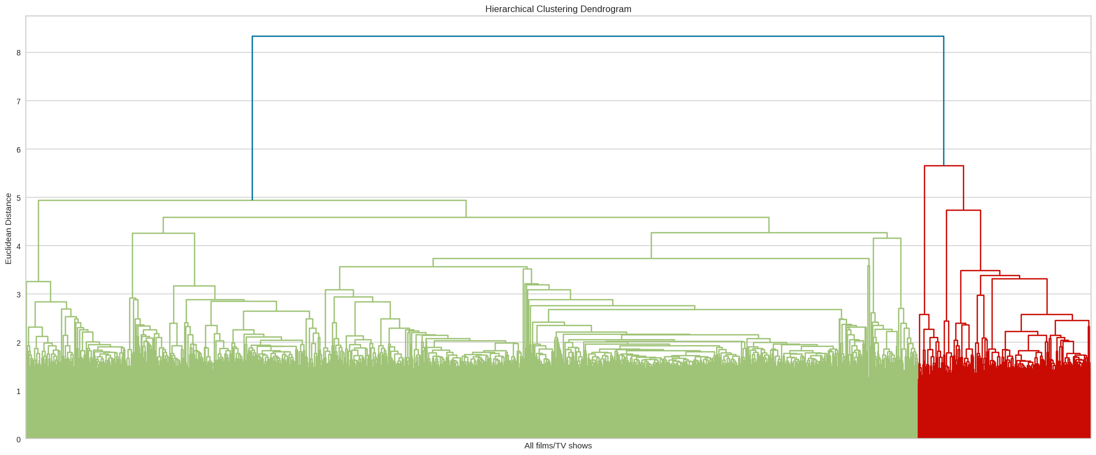
2.Agglomerative Clustering
In agglomerative clustering no need to give the value of k beforehand
The agglomerative hierarchical clustering algorithm is a popular example of HCA

Slide 23
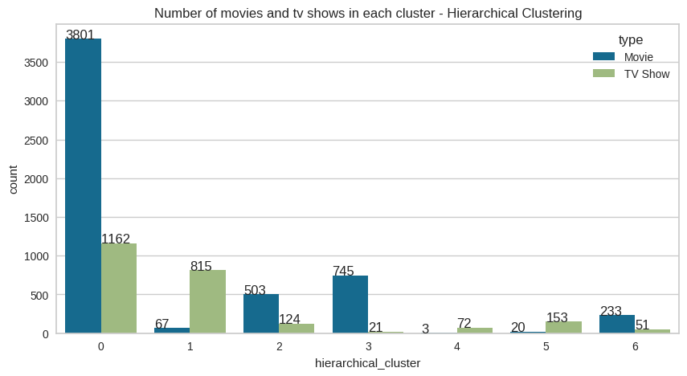
Agglomerative Clustering

Slide 24
Conclusion
From elbow and silhouette score ,optimal of 26 clusters formed , K Means is best for identification than Hierarchical as the evaluation metrics also indicates the same.In kmean cluster 0 has the highest number of datapoints and evenly distributed for other cluster
Netflix has 5372 movies and 2398 TV shows, there are more movies on Netflix than TV shows.
TV-MA has the highest number of ratings for tv shows i,e adult ratings
highest number of movies released in 2017 and 2018 highest number of movies released in 2020 The number of movies on Netflix is growing significantly faster than the number of TV shows. We saw a huge increase in the number of movies and television episodes after 2015. there is a significant drop in the number of movies and television episodes produced after 2020. It appears that Netflix has focused more attention on increasing Movie content than TV Shows. Movies have increased much more dramatically than TV shows

Slide 25
Conclusion
The most content is added to Netflix from october to january.
Documentaries are the top most genre in netflix which is followed by stand up comedy and Drama and international movies.
Kids tv is the top most TV show genre in netflix.
Most of the movies have duration of between 50 to 150.
Highest number of tv_shows consisting of single season.
Those movies that have a rating of NC-17 have the longest average duration..
When it comes to movies having a TV-Y rating, they have the shortest runtime on average.
United states has the highest number of content on the netflix ,followed by india.
India has highest number of movies in netflix.
30% movies released on Netflix. 70% movies added on Netflix were released earlier by different mode.

Slide 26
Thank you

